Slide 1


New MSc student orientation
Faculty of Life Sciences
Fall 2026
Iftach Nachman iftachn@tauex.tau.ac.il

Slide 2
Welcome!
Focus of the MSc: Research
Difference from BSc
Science: Failures – part of the process.
Devote full time to research.
  … then TA work
  … then courses

Slide 3
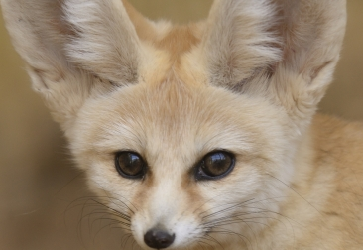
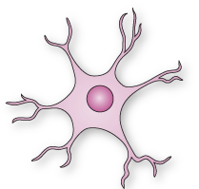

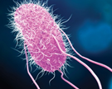
Faculty Schools
1
Zoology
Neurobiology, Biochemistry and Biophysics
Plant Science and Food Security
Shmunis school for Biomedicine and Cancer Research
Lab<->School vs. MSc program

Slide 4
Plan your MSc!
Year I
Studies, Learning in Lab
Year II
Getting Results
1/10/26
30/9/28
Study > 20 points
Learn to be a scientist
  Research techniques
  Planning experiments
  Writing
  Presenting
Study <= 10 points
Higher productivity
Thesis writing: last month.

Slide 5
Advisor/student relationships
Autonomy level: Micromanagement <-> Neglect
Recommended: ½ yearly evaluation meetings
  Set expectations
  Planned vs. achieved.
  What went well?
  What should be improved?
How to handle problems?

Slide 6
Fellowships
All accepted students get fellowships
Exempt of tuition
  Except the initial “תשלומים נלווים”
Junior faculty organization: ארגון סגל ההוראה והמחקר https://www.segel.org.il
Extension due to Miluim/maternity leave - request

